Slide 1
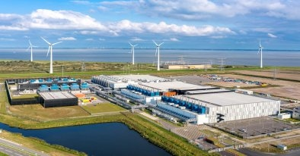
Week 15-Lec 1
Data center Networking

Slide 2
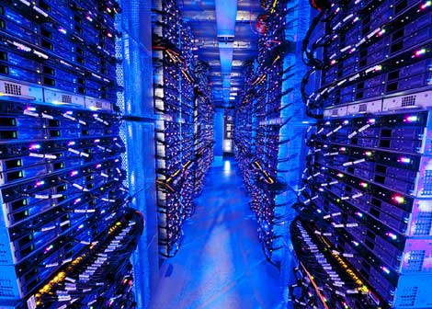
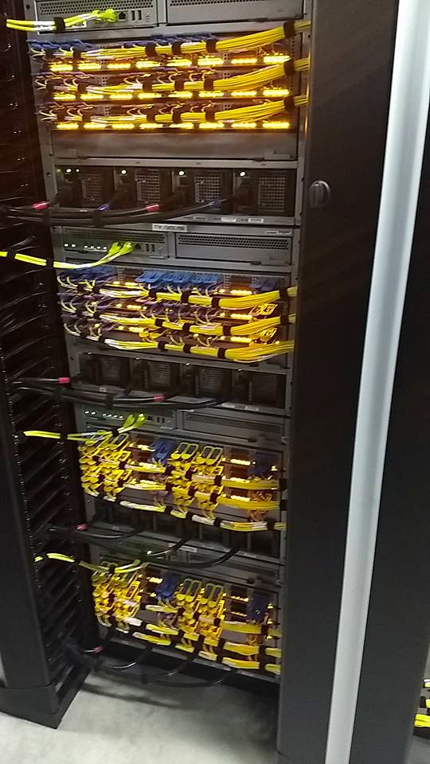
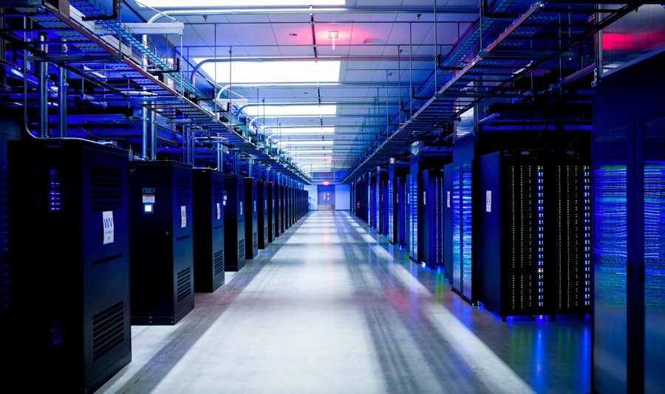
Data center networks
Inside a 40-ft Microsoft container,
Chicago data center
10’s to 100’s of thousands of hosts, often closely coupled, in close proximity:
e-business (e.g. Amazon)
content-servers (e.g., YouTube, Akamai, Apple, Microsoft)
search engines, data mining (e.g., Google)
challenges:
multiple applications, each serving massive numbers of clients
managing/balancing load, avoiding processing, networking, data bottlenecks
Inside Facebook’s datacenter

Slide 3
Data center networks
load balancer: application-layer routing
receives external client requests
directs workload within data center
returns results to external client (hiding data center internals from client)
Internet
Border router
Load
balancer
Load
balancer
Access router
B
Tier-1 switches
A
C
Tier-2 switches
TOR switches
Server racks
1
2
3
4
5
6
7
8

Slide 4
Connectivity
The hosts (blades)
Include CPU, memory, and disk storage.
Stacked in racks, with each rack typically having 20 to 40 blades.
At the top of each rack there is a switch, Top of Rack (TOR) switch
interconnects the hosts in the rack with each other and with other switches in the data center
Each host has a NIC card that connects to its TOR switch,
Each TOR switch has additional ports that can be connected to other switches.
hosts below each access router form a single subnet.
In order to localize ARP broadcast traffic,
each of these subnets is further partitioned into smaller VLAN subnets
each comprising a few hundred hosts

Slide 5
Traffic types
traffic flowing between external clients and internal hosts
One of more Border routers – Data center to public Internet
Traffic flowing between internal hosts
External requests directed to load balancer
Distribute jobs/requests to servers
Destination port num and IP address

Slide 6
How
are
datacenter
networks
different
from
networks
we’ve seen
before?
•
Scale: very few local networks have so many machines in one place:
10’s of thousands of servers — and they all work together like one computer!
•
Control:
Internet, software
entirely administered by one organization — unlike the
datacenter owners control every switch in the
on every host
network and
the
•
Performance: datacenter latencies are 10s of us, with
100Gbit links.
10, 40, even
How do these factors change how we design datacenter
networks?

Slide 7
Desirable
Properties
•
Low Latency: Very few “hops” between destinations
•
Resilience: Able to recover from link failures
Good Throughput: Lots of endpoints can communicate,
same time.
•
all at the
•
Cost-Effective: Does not rely too much on expensive equipment like
very high bandwidth, high port-count switches.
•
Easy to Manage: Won’t confuse network administrators who have to
wire so many cables together!

Slide 8
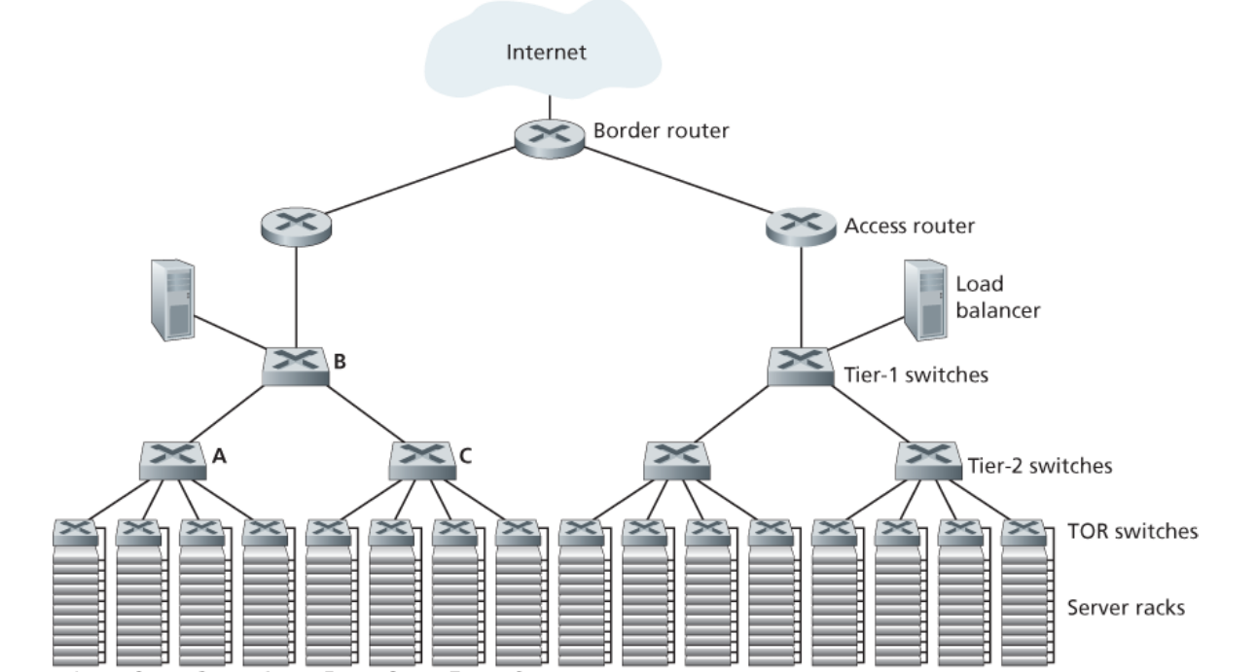
Limitations:
host-host capcacity

Slide 9
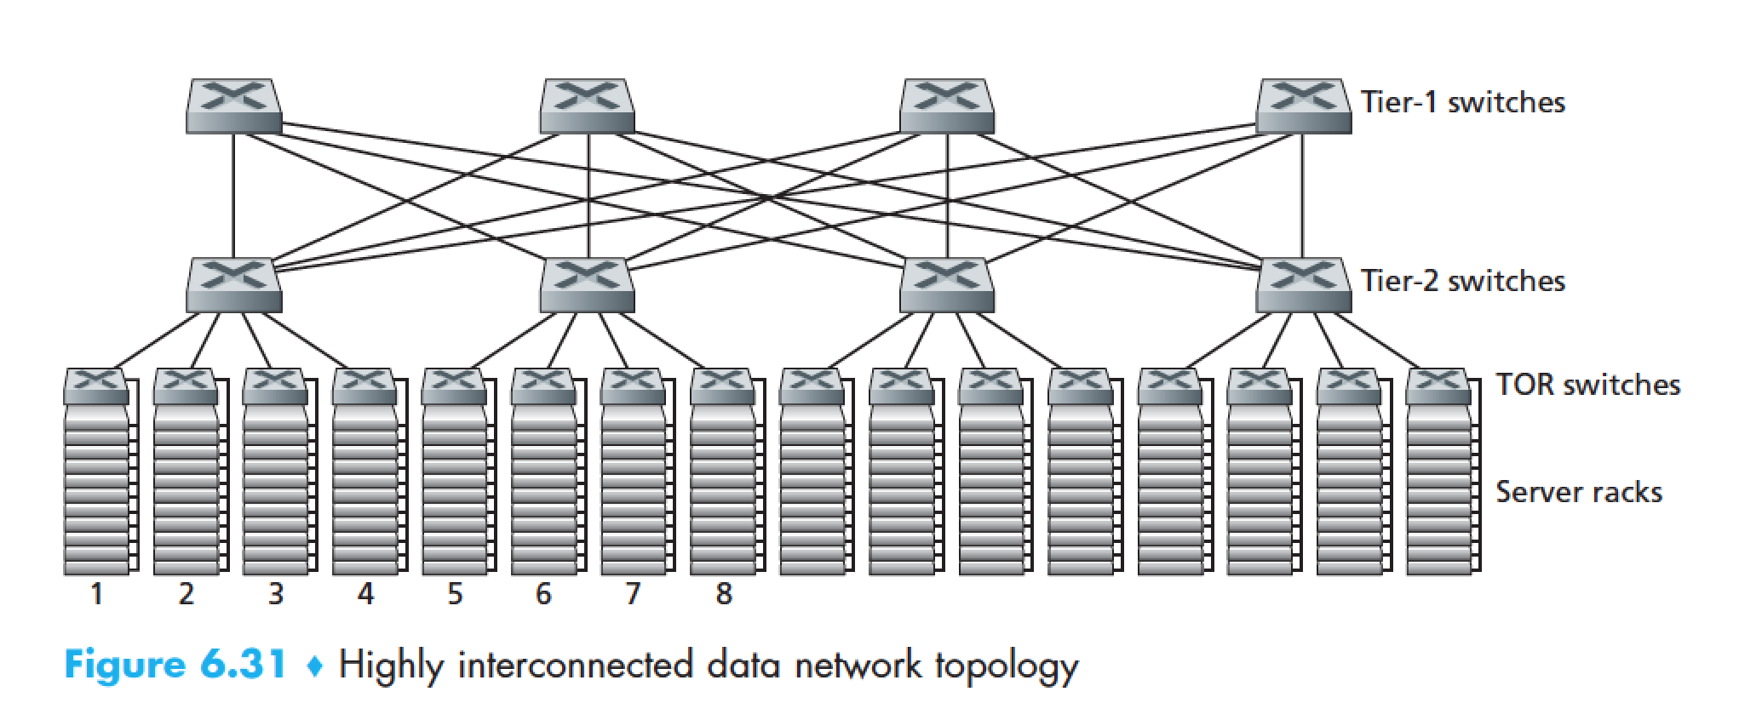
Datacenter networks: multipath
rich interconnection among switches, racks:
increased throughput between racks (multiple routing paths possible)
increased reliability via redundancy
9
10
11
12
13
14
15
16
two disjoint paths highlighted between racks 1 and 11

Slide 10
Datacenter networks: application-layer routing
Internet
load balancer: application-layer routing
receives external client requests
directs workload within data center
Load
balancer
…
…
…
…
returns results to external client (hiding data center internals from client)
…
…
…
…

Slide 11
Datacenter networks: protocol innovations
link layer:
RoCE: remote DMA (RDMA) over Converged Ethernet
transport layer:
ECN (explicit congestion notification) used in transport-layer congestion control (DCTCP, DCQCN)
experimentation with hop-by-hop (backpressure) congestion control
routing, management:
SDN widely used within/among organizations’ datacenters
place related services, data as close as possible (e.g., in same rack or nearby rack) to minimize tier-2, tier-1 communication
Google Networking: Infrastructure and Selected Challenges (Slides: https://networkingchannel.eu/google-networking-infrastructure-and-selected-challenges/

Slide 12
Google’s Data center

